Slide 1
Competitiveness in the EU: whatever it takes to innovate
Alexandr HOBZA
Chief Economist, Directorate General Research & Innovation, European Commission
Notes:
Whatever It Takes to Innovate: Draghi’s Plans for EU Competition Policy - Kluwer Competition Law Blog

Slide 2
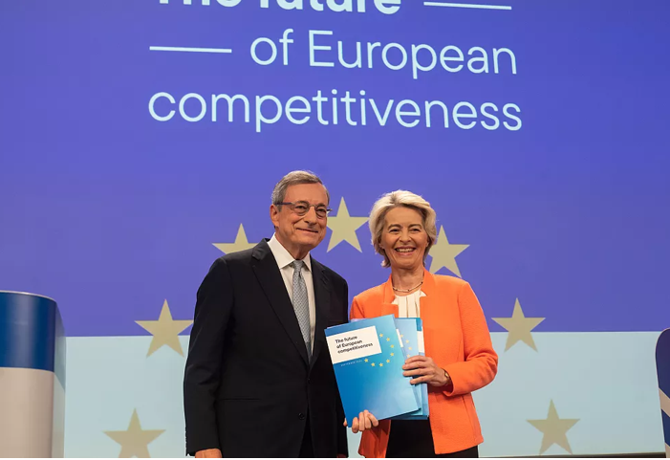

The Draghi assignment ...

Slide 3


What do we mean by competitiveness after all?
Concept
Measure of competitiveness
Ability (of a country) to compete in external markets
Current account balance
Indicators of relative prices and costs
Ability (of a country) to sustainably raise living standards
Productivity
There are different policy implications in the fragmented, geopolitical and generally more uncertain world …

Slide 4





(New) challenges to promoting competitiveness
POPULATION AGEING
UNCERTAINTY
GEOPOLITICAL DEVELOPMENTS
CLIMATE CHANGE
INCLUSION
Working-age population will shrink by 41 mn. by 2070 (without migration by additional 46 mn.), i.e. over 30%. Labour productivity will be key to cater for the social needs of an ageing society.
We have entered an era of polycrisis/
permacrisis. Need to make our economies and societies more resilient to shocks.
Geopolitical tensions point to economic security issues and trade dependencies, including as regards energy systems, raw materials or technological sovereignty.
Need a fundamental overhaul of economic and societal structures. 35% of cumulative C02 emissions reduction needed to meet our 2050 net zero goal depends on new technologies.
Ensure that the green and digital transitions involve everybody, with widespread uptake of digital and net-zero technologies and that its cost is not borne by the worse-off regions and parts of society.

Slide 5
EU versus US labour productivity 1890-2022
1890
1900
1910
1920
1930
1940
1950
1960
1970
1980
1990
2000
2010
2020
Note: The EU is proxied by backdating national accounting data from Germany, France, Italy, Spain, the Netherlands, Belgium, Ireland, Austria, Portugal, Finland and Greece. To build the labour productivity data, five different series were used: GDP, capital stock, employment, average hours worked, and population. Capital stock is built using two series of investment – construction and equipment. Investment and GDP are taken in volume and in national currency of 2010, they are then turned into $2010 using a ppp conversion rate.
Source: Bergeaud, A., Cette, G. and Lecat, R., 2016.
Notes:
https://climate.nasa.gov/vital-signs/carbon-dioxide/

Slide 6
Productive investment
Real gross fixed capital formation excluding residential investment, % of GDP
19
18
US
17
EU (without Ireland)
16
-1.5
15
14
13
12
1
0
01/01/2000
01/01/2005
01/01/2010
01/01/2015
01/01/2020
01/07/2023
Source: EIB, 2024.
Notes:
https://climate.nasa.gov/vital-signs/carbon-dioxide/

Slide 7
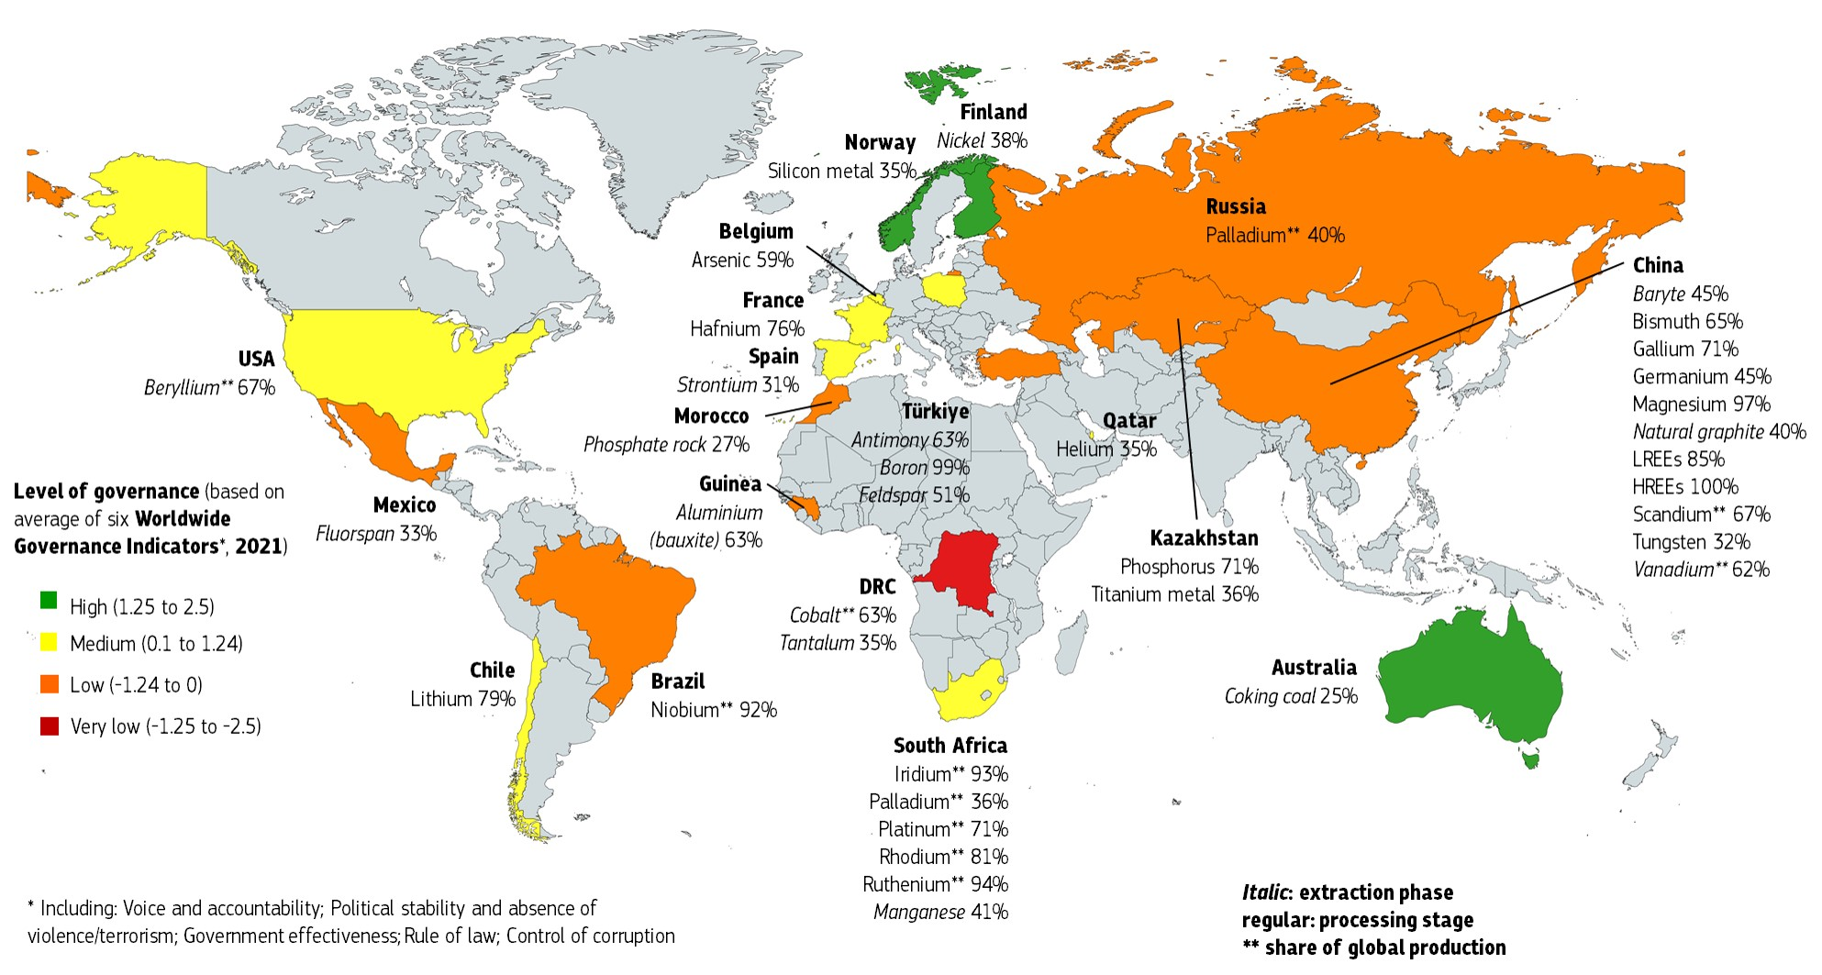
Major EU suppliers of CRMs and their governance ranking
2023
Source: European Commission, 2023.
Notes:
https://climate.nasa.gov/vital-signs/carbon-dioxide/

Slide 8
Draghi’s three transformations for Europe
Closing the innovation gap → accelerate innovation and find new growth engines.
A joint decarbonisation and competitiveness plan →bring down high energy prices while continuing to decarbonise.
Increasing security and reducing dependencies → react to a world of less stable geopolitics, where dependencies are becoming vulnerabilities and it can no longer rely on others for its security.

Slide 9
Closing the innovation gap ...
European Innovation Scoreboard
US
EU
+5
China
+50
Source: European Commission, 2024.
Notes:
https://climate.nasa.gov/vital-signs/carbon-dioxide/

Slide 10
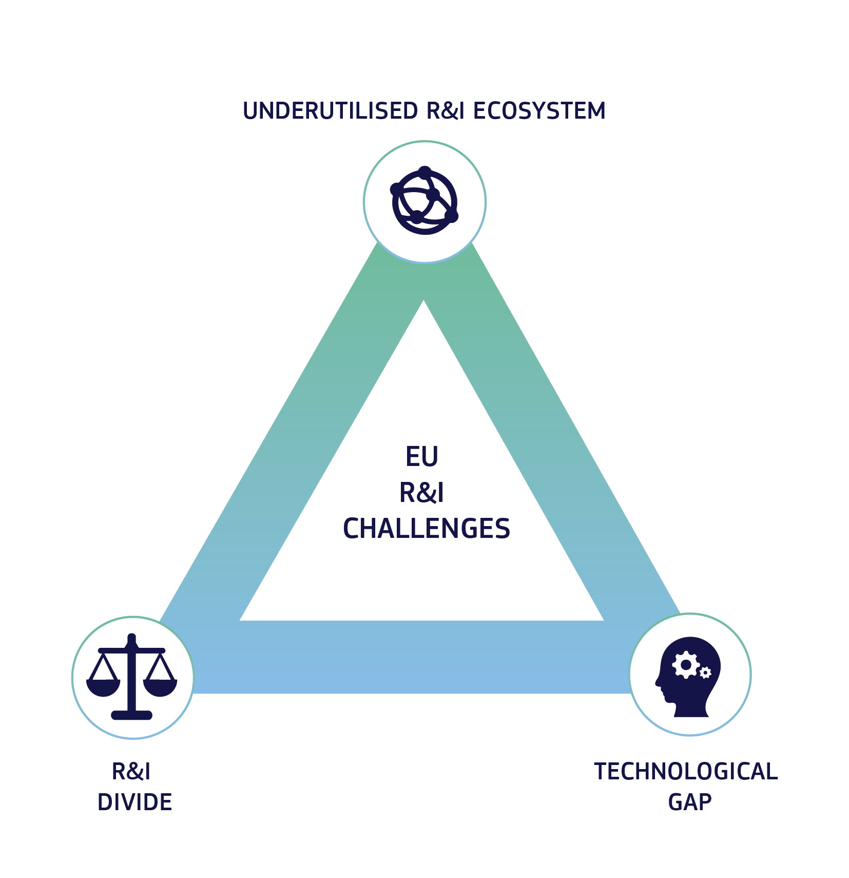
The dimensions of the EU innovation gap
Underutilised R&I ecosystem
R&I divide
Technological gap

Slide 11
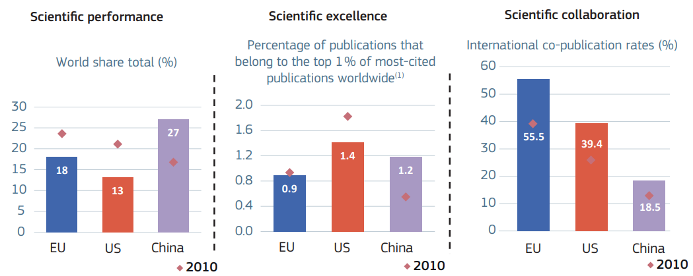
Scientific performance, excellence and collaboration
Scientific performance, excellence and collaboration – EU, US and China, 2022
Science, Research and Innovation Performance of the EU 2024
Notes:
Short version:
We also show that Europe is still a strong scientific player, producing around 18% of global scientific publications, better than the US but behind China, which has seen a significant expansion over the years.
In terms of publication quality, measured here by the top 1% most cited papers, Europe lags behind the US and China, which have improved both quantity and quality.
Now Europe excels in international co-publication rates, but there is still room for improvement as I will show in a few slides.
Long version:
Here, you see first scientific performance in terms of publications. There, Europe has been producing around 1/5 of global output in terms of papers, some 18%, and there we are a bit better than the US but worse than China, which again experienced a huge expansion over recent years.
However, if we compare this volume of publications by their quality, and here we are using a measure of the percentage of publications which belong among the top 1% most cited, there we see that the picture is changing. Europe’s share is lower than that of the US, which leads globally, but also lower than that of China, which has improved not only the quantity but also the quality of its publications.
Where Europe is doing quite well is in the international co-publication rate, so cooperation is very important. But, as I will argue later on in my talk, even there, there is quite a lot of scope for Europe to further exploit and improve.

Slide 12
R&D intensity
R&D intensity, GERD as % of GDP, by source of funding, 2021
3.5
2.3
2.4
Business
Government
Higher education and PNP
0.1
RoW
0.0
EU
US
China¹
1 Except Hong Kong.
Note: PNP refers to private non-profit sector; RoW refers to rest of the world.
Source: European Commission, 2024. Based on Eurostat and OECD.
Notes:
https://climate.nasa.gov/vital-signs/carbon-dioxide/

Slide 13
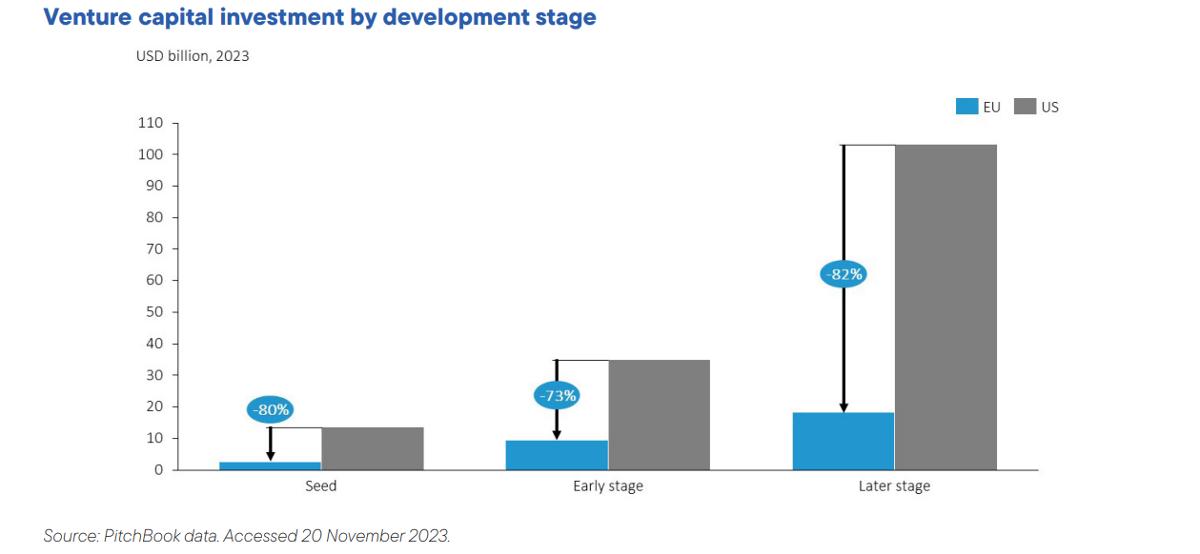
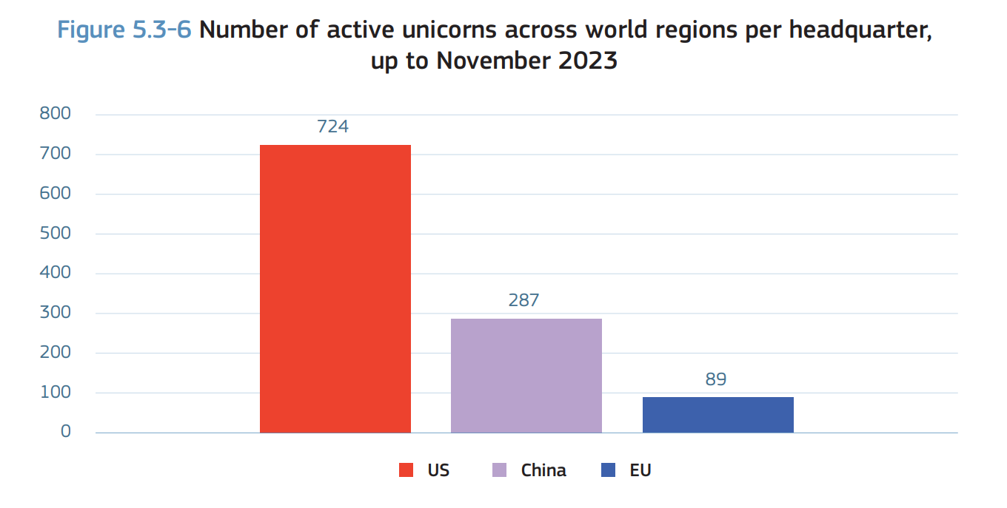
Access to innovation finance and scaling gap
Draghi report 2024 and Science, Research and Innovation Performance Report 2024
Notes:
Short version:
Despite, the progress made the EU still struggle to reach the necessary scale to meet all its objectives.
The EU VC market remains considerably underdeveloped, also due to the fragmentation of the European financial system
The gap with the US is observable at all development stage, but it is more pronounced in the scale-up phase.

Slide 14
The technology gap: top private R&D spenders
Top 3 R&D spenders and their industries in the EU and the US
 | 2003 | 2012 | 2022
US | Ford (auto) Pfizer (pharma) GM (auto) | Microsoft (software) Intel (hardware) Merck (pharma) | Alphabet (software) Meta (software) Microsoft (software)
EU | Mercedes-Benz (auto) Siemens (electronics) VW (auto) | VW (auto) Mercedes-Benz (auto) Bosch (auto) | VW (auto) Mercedes-Benz (auto) Bosch (auto)
Source: Gros et al. Based on Industrial R&D Investment Scoreboard, 2024.
Notes:
https://climate.nasa.gov/vital-signs/carbon-dioxide/

Slide 15
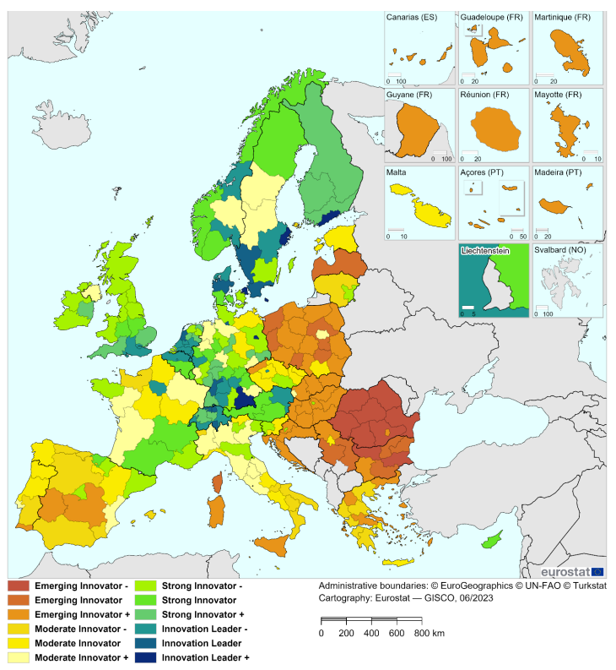
Research and innovation divide
Regional Innovation Scoreboard 2023
Notes:
Of course, the pattern is not as simple, and also within countries, you can see patterns of specialisation with some regions doing much better than others. The regional aspect of innovation performance is very present there.
Here, in this map, you can see the results of the regional innovation scoreboard from last year, which ranks individual regions in different member states by their innovation capacity.
This, on the one hand, should not surprise us because innovation performance has a tendency to concentrate.
Innovation thrives most in clusters when different actors are close to one another and then can exchange and spillovers can take place. On the other hand, excessive concentration is also not good because we're not using our available resources or capacity to the utmost.

Slide 16
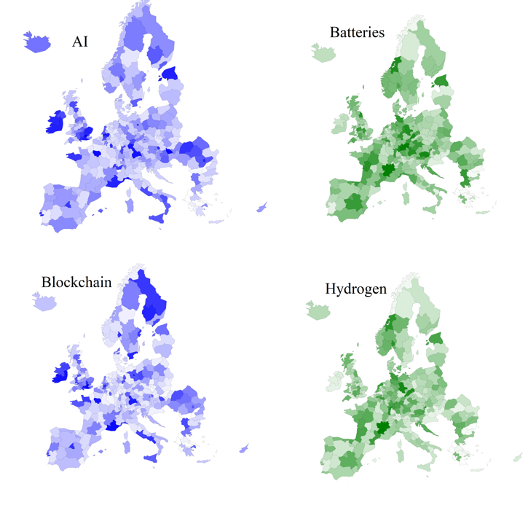
Regions’ capacity to develop key technologies

Slide 17
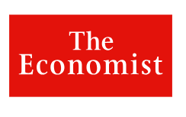
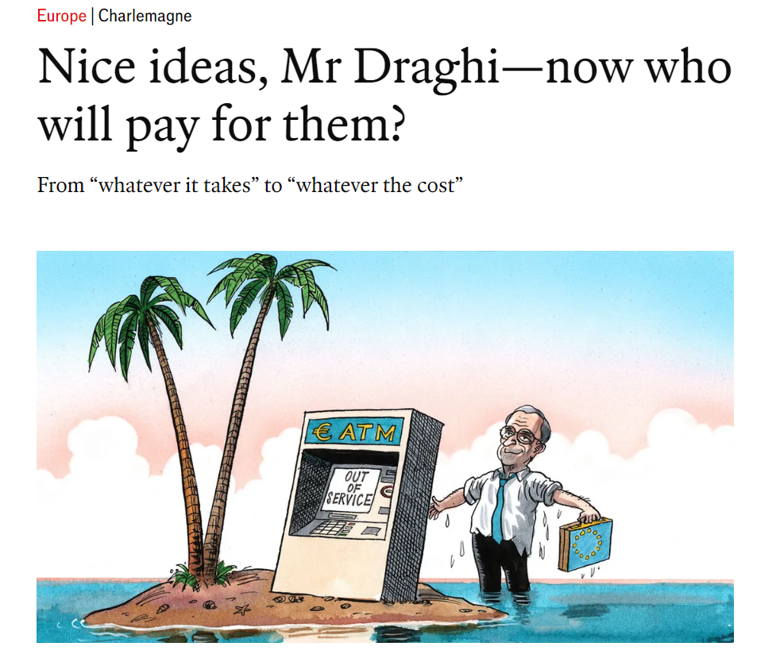

Slide 18
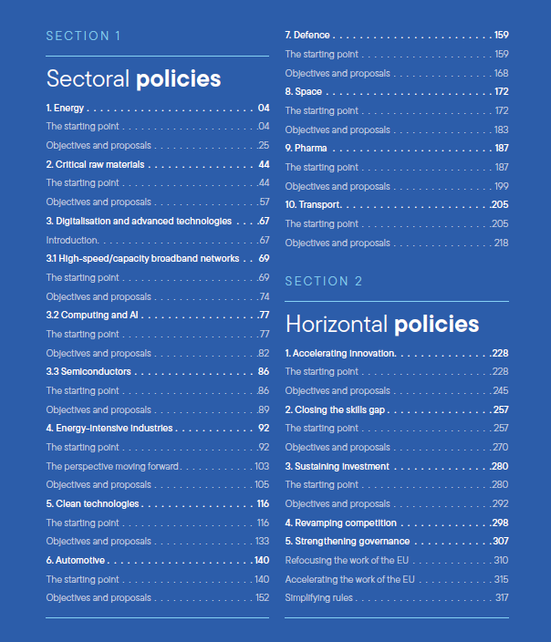

A detailed set of proposals for 10 sectors and 6 horizontal policies

Slide 19
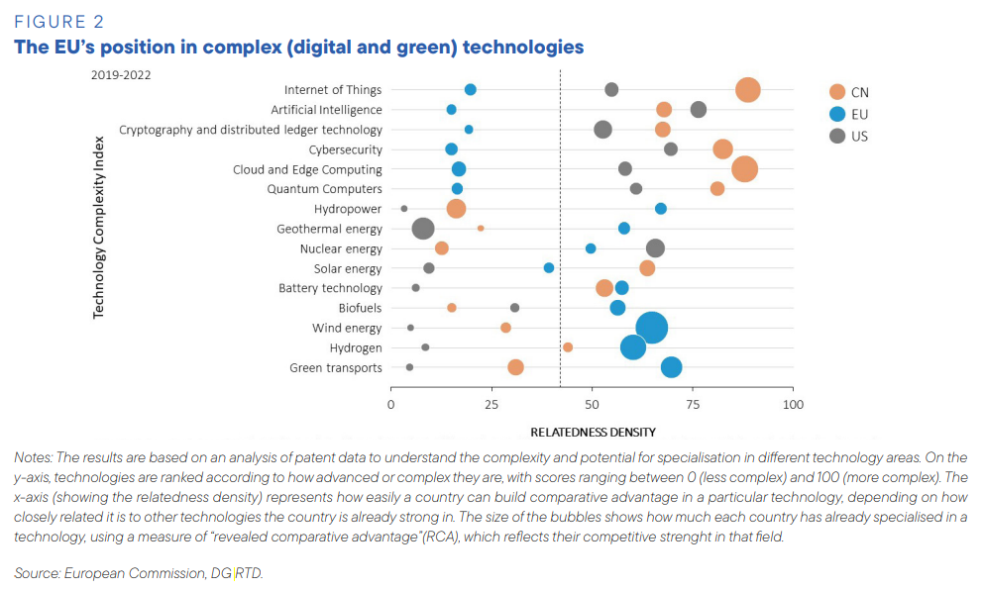
The technology gap: complexity matters
Draghi report and Science, Research and Innovation Performance of the EU 2024
Notes:
Short version:
And we looked deeper into this, using a complexity approach to rank technologies by degree of complexity or sophistication, which we explain in the report.
And looking at the current specialisation, which is the size of the bubbles here, but also the potential for future specialisation, which is on the horizontal axis, what we see is that we do better in less complex technologies, mostly green technologies which are important for our future, but we lag behind in digital technologies, which are ranked with higher complexity.
The US and China have significant potential and capacity for digital technologies.
This matters because digital technologies are general-purpose technologies that can enhance the performance of all sectors in the economy.
Long version:
In this graph, you can see results of our analysis using the complexity approach, which helps us to rank technologies according to their degree of sophistication or complexity. Here, in the graph, the most sophisticated and complex technologies are on the top, so we start with the most complex and then basically go down. On the horizontal axis, you can see the potential of Europe and our competitors to develop specialisation in these technologies. The more to the right, the bigger potential you have to develop.
When you look at the results, Europe again is marked as blue. In the most sophisticated technologies, starting with the Internet of Things, artificial intelligence, cloud, and quantum computers, we actually do not have that much existing potential to develop specialisation.
Whereas we do much better in the less complex technologies, and in this case, we have mostly green technologies, which are also an important element of our technology mix for the future. There, we do reasonably well but much less than for digital technologies.
If you look at the situation of the US or China, it's exactly the opposite picture. They have a huge potential, already existing capacity but also potential to further develop in digital technology compared to Europe.
Why does this matter? In particular, because these digital technologies are so-called transversal technologies or general-purpose technologies which are used across the economy and then also feed into the performance of other sectors. This is why it is important to also build up capacity in these sectors. However, our analysis shows that it's not an easy thing to do. We have to do it, but it will require quite important efforts.

